Slide 1

May Flowers
🐍CodeX Monthly Project

Slide 2
May Flowers
A common saying is “April showers bring May flowers.”
In the last project, you programmed April showers, so in this project you will program May flowers.
So grab your CodeX,
Open your April Showers project and get ready to write some code!

Slide 3
May Flowers
Time to code!
Log in to make.firialabs.com and go to the Sandbox.
Open the April_Showers program.
Run the code and make sure it is bug-free.
Everything good? Great! Ready to continue…

Slide 4
May Flowers
Step 1: Create a flower
Add a function to the program that will draw a single simple flower.
Use circles for the flower.
You will use a loop to repeat the flower several times on the screen.

Slide 5
May Flowers
Step 1: Create a flower
The code shown here is an example of a simple small flower. You can use this one or create one of your own.
Use x and y as parameters so the flower can be duplicated many times in different positions across the screen.

Slide 6
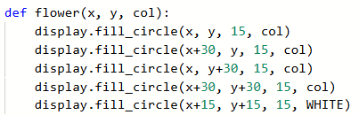
May Flowers
Step 1: Create a flower
The center of each flower will be WHITE.
The parameter col will be the color of the flower.

Slide 7

May Flowers
Step 1: Create a flower
Check out the flower by adding this test code to the Main Program.
  Don’t delete what is there! Just add this code above!
Stop the code and make any adjustments to your flower before continuing.

Slide 8
May Flowers
Step 2: Display several flowers
Add one more function that will call flower() several times to display flowers on the screen.
You could select random numbers for x and y and place them all over the screen, or display them in neat rows and columns.
The code will show you neat rows and columns.

Slide 9
May Flowers
Step 2: Add the function to display 6 flowers
Create a new function: may_flowers().
It will use an inner loop for the flowers across,
And an outer loop for the rows of flowers.
You will increment the x to go across (columns), and the y for the rows.

Slide 10
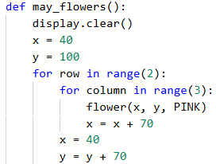
May Flowers
Step 2: Add the function to display 6 flowers
Initialize the x and y for the first flower.

Slide 11
May Flowers
Step 2: Add the function to display 6 flowers
Let’s examine the code
Draw two rows of flowers
(reset x and update y)
(x, y) coordinates for first flower
Draw three flowers across

Slide 12

May Flowers
Step 2: Add the function to display 6 flowers
Check out the flowers by adding this test code to the Main Program.
  Just change the test code from Step 1.
Stop the code and make any adjustments to the loops before continuing.

Slide 13
May Flowers
Step 3: Add text and ground
The May flowers look good, but the screen seems incomplete.
Add a rectangle for the ground and text to show they are May flowers.

Slide 14
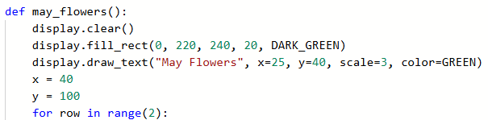
May Flowers
Step 3: Add text and ground
This code is an example of what you can add to the May flowers screen.
Run the code again, and make any adjustments.

Slide 15
May Flowers
Step 4: Colorful flowers
A bunch of PINK flowers is nice, but May flowers come in many colors.
Create a list of flower colors.
A list is usually defined near the top of a program.

Slide 16
May Flowers
Step 4: Colorful flowers
Here are the pre-defined colors. Pick the colors you want to use for the flowers.
Or, if you know how, create your own RGB color triplets.

Slide 17
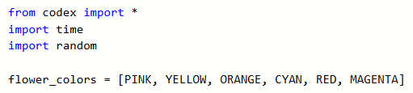
May Flowers
Step 4: Colorful flowers
Here is an example of a flower_colors list.
You can have as many colors as you want.

Slide 18
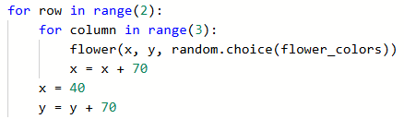
May Flowers
Step 4: Colorful flowers
Select a random color from the list in the may_flowers() function.

Slide 19
May Flowers
Step 4: Colorful flowers
Test the code by running it several times.
After each run, stop the code and then run again.
You should see random colors for the flowers every time.
Make any modifications before continuing.

Slide 20
May Flowers
Step 5: Make it interactive!
You have the functions and list.
You’ve done the testing.
Now make it interactive with a button press.
Take out the test code in the Main Program.

Slide 21
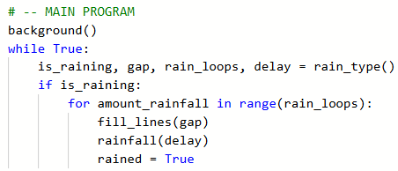
May Flowers
Step 5: Make it interactive!
You only want the flowers to appear after rain, so add another Boolean variable to indicate rain.

Slide 22
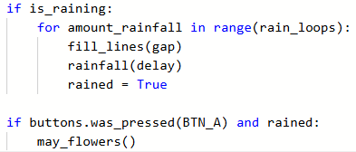
May Flowers
Step 5: Make it interactive!
Add an if statement with a button press for the May flowers. Include the Boolean rained.
  Watch your indenting! It is even with the first if statement.

Slide 23
May Flowers
Step 5: Make it interactive!
While testing the code you notice a couple of things:
You can alternate between showers and flowers, but the showers appear over the flowers before showing the words “April Showers”.
It would be nice to have a button press end the code.
Both of these are easy fixes.

Slide 24
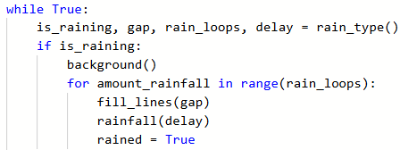
May Flowers
Step 5: Make it interactive!
Call the background() function before starting the rain.

Slide 25

May Flowers
Step 5: Make it interactive!
Add another if statement with a button press to break the loop.
Watch your indenting! It is the same as the other if statements.

Slide 26

May Flowers
Happy Spring!
Now you have April Showers
AND May Flowers.
Add other features to make the code uniquely yours!

